Slide 1
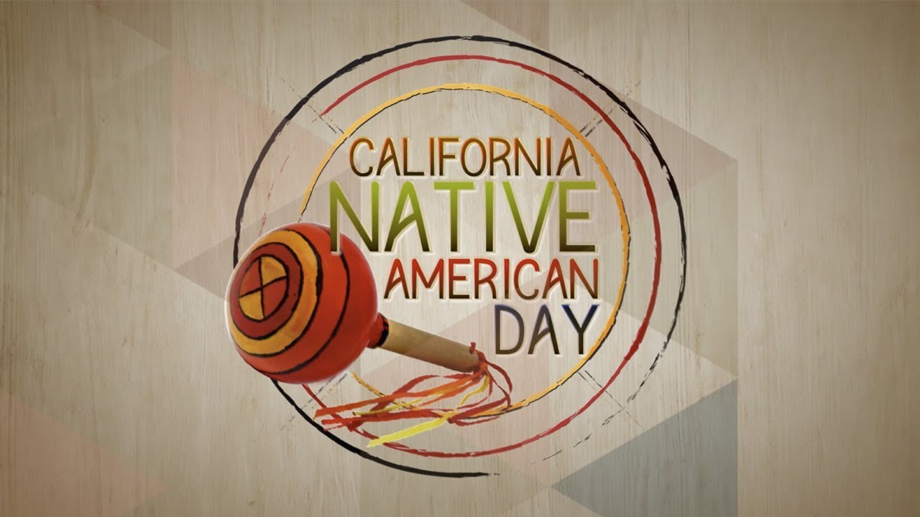

California Native American Day
Human Relations, Diversity & Equity
Student Support and Attendance Services
Notes:
There is discussion whether the preferred term should be Native American, American Indian, or Indigenous American. For purposes of this document, we are echoing the language of “California Native American Day”

Slide 2

reflection
What do you think it was like in Los Angeles 200 years ago?
… before the freeways,
… before all the buildings

Slide 3
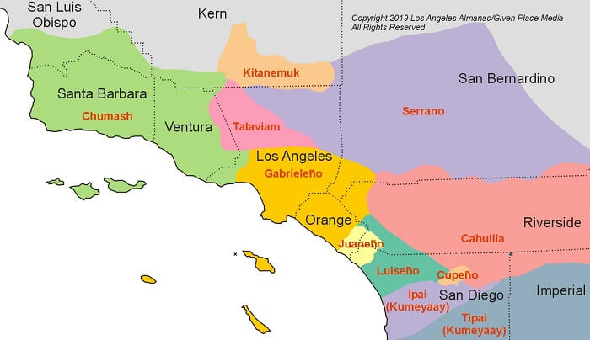
The Ventureño (aka Chumash), Gabrieleño (aka Tongva), and Fernandeño Native American Indians were the first people of Los Angeles.
They have lived here for over 1500 years.

Slide 4

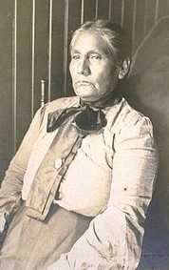

Colonization & Missions
During colonization, the tribes were called by the names of the Spanish mission that were built on their territory.
These are not the names by which the different villages described themselves.
Notes:
Narcisa Higuera was one of the last fluent Tongva speakers. This picture was taken in 1905.

Slide 5
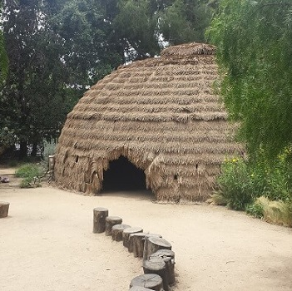
The Gabrieleño
The Gabrieleno lived in South Los Angeles, and parts of Orange, San Bernardino and Riverside counties.
They lived peacefully and valued courage and respect.

Slide 6
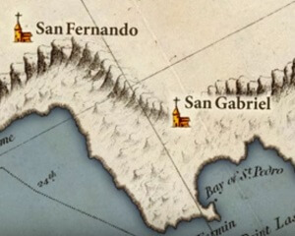
The Fernandeño
The Fernandernos lived in what we now call the San Fernando Valley.
They called it the Valley of Smoke due to the smog caused by pollen and camp fires.

Slide 7
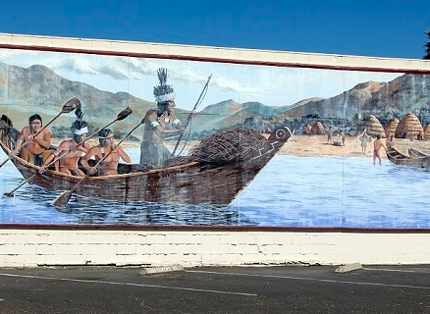
Chumash
The Chumash lived in what became Malibu, Ventura and Santa Barbara

Slide 8
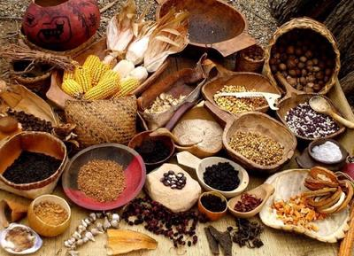
The area was rich with acorns, pine nuts, small game, and fish.

Slide 9
Spanish Invasion
The Native American Indians of Los Angeles suffered terribly at the hands of the Spanish.
Their lands were stolen, they were forced to give up their religions, languages, culture, and traditions.
Many died from diseases and maltreatment.

Slide 10
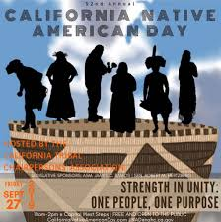
Honor and Acknowledge
There are many Native Americans living in Los Angeles.
Every 4th Friday in September we recognize California Native American Day to honor them and acknowledge their lands upon which we stand today.

Slide 11
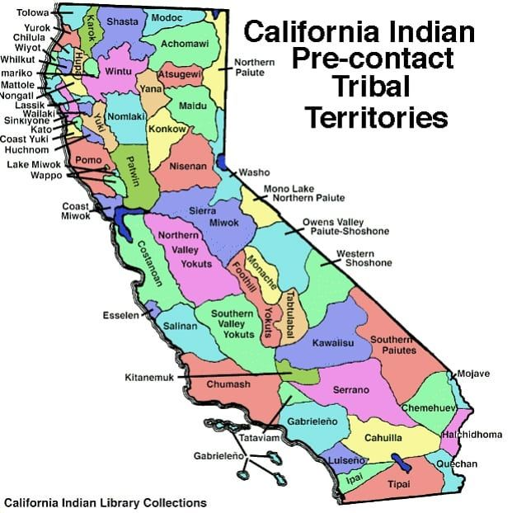
Acknowledge the first people of this land
To find out on whose land you are on, follow this link https://native-land.ca/ and enter your address.
For more information, visit LAUSD Title VI American Indian/Alaskan Native & Indigenous Education Program
Notes:
Download the teachers’ guide https://native-land.ca/wp/wp-content/uploads/2019/03/teacher_guide_2019_final.pdf
For more information, visit http://www.indianedla.net/

Slide 12


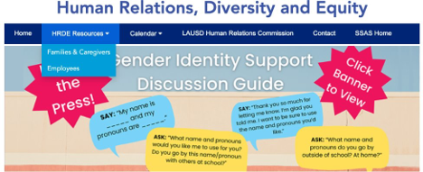

Human Relations, Diversity & Equity
For additional resources, visit us at: https://www.lausd.org/human-relations

Slide 13


Teacher Feedback Survey
Notes:
Teacher, please scan the QR code to complete the survey:

